Slide 1
Signal development in anodes
Hervé Grabas whit the help of David McGinnis

Slide 2
System to simulate

Slide 3
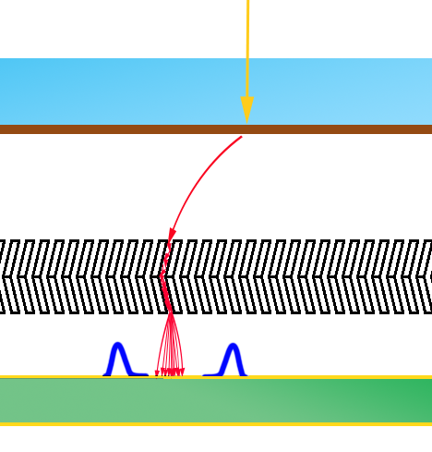
Objectives
Look at how the electrons travelling the gap are inducing pluse on the stripline.
Can we make a better coupling?
What are the key parameters?
Input photons
Photocathode
MCP1
MCP2
Stripline

Slide 4
Modelisation of the problem
$$Q\left(x,y,z,t\right)= Qδ(x)δ(y)δ(z(t))$$
Therefore:
$$i\left(x,y,z,t\right)= \frac{dQ}{dt}=Qδ(x)δ(y)\frac{dδ(z\left(t\right))}{dt}$$
Charge path coming from the MCP.
$δ$ function is not differentiable.

Slide 5
Modelisation of the charge

Slide 6
Position of the charge

Slide 7
Modelisation of the current

Slide 8
Plot of the charge and current

Slide 9
Electromagnetics equations

Slide 10
Surface current

Slide 11
Improve timing resolution: Parameters
Sharper current induced pulses are produced on the anode for:
Higher voltage
Smaller gap
Smaller spatial charge distribution
Higher charge

